Slide 1

Subscribers Galore : Exploring World’s Top YouTube Channels…

Slide 2
INTRODUCTION
Overview
A subscribers to a channel on the video-sharing YouTube is a user who has chosen to receive the channel's content by clicking on that channel's "Subscribe" button, and each user's subscription feed consists of videos published by channels to which the user is subscribed.
Purpose
Most-subscribed YouTube channels, as well as the primary language and content category of each channels.

Slide 3
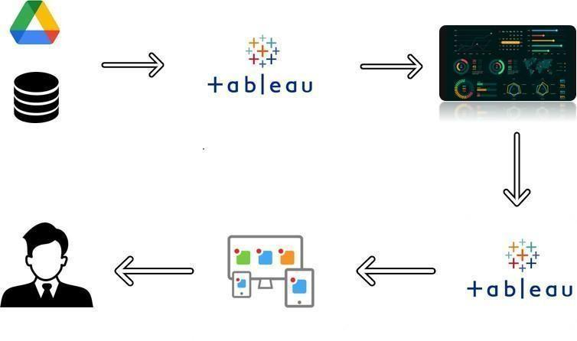
Subscribers Galore : Exploring World’s Top YouTube Channels
Creating Dashboard, Story using Tableau for Top YouTube Channel
Project Description:
A subscriber to a channel on the video-sharing YouTube is a user who has chosen to receive the channel's content by clicking on that channel's "Subscribe" button, and each user's subscription feed consists of videos published by channels to which the user is subscribed. The ability to subscribe to users was introduced in October 2005. YouTube began publishing a list of its most- subscribed channels in April 2006. An early archive of the list dates to May 2006.
Technical Architecture:

Slide 4

Problem Definition & Design Thinking;
Empathy map
Says
What have we heard them say? What can we imagine them saying?
Thinks
What are their wants, needs, hopes, and dreams? What other thoughts might influence their behaviour?
Those channels may share socialism with their contents
Exploring these very interesting
They can spread any messages easily all over the world
They can play a major role in worlds problems, things, and others.
These YouTube channels which has more subscribers are useful to educating, exploring, and many
Nowadays YouTube is having a major role in day to day life
Subcribers galore
Subscribers galore
Short summary of the subcribers galore
Short summary of the subscribers galore
Spread socialism with their content
Spread more educating contents
Delighted
Help by motivating their subscribers can lead a major in societies
Exuberant
Vanity
Does
What behaviour have we observed? What can we imagine them doing?
Feels
What are their fears, frustrations, and anxieties? What other feelings might influence their behaviour?

Slide 5


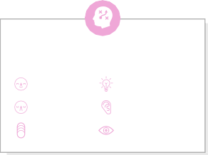



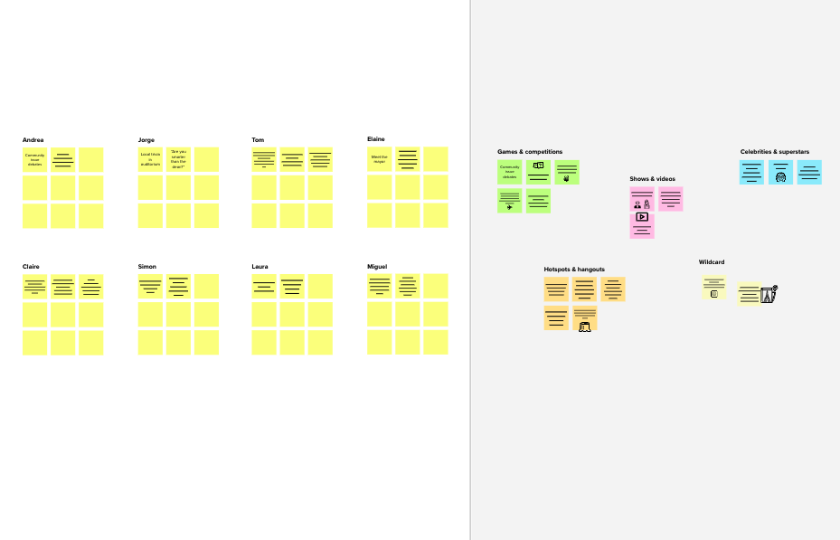
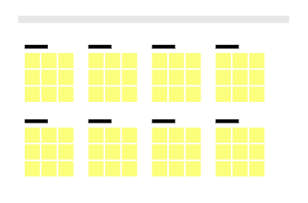
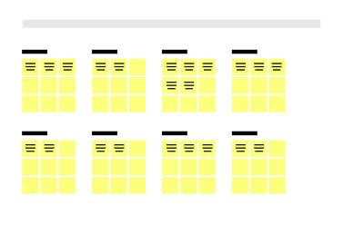
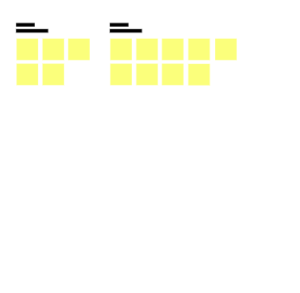
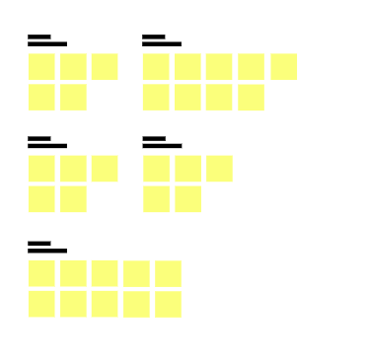
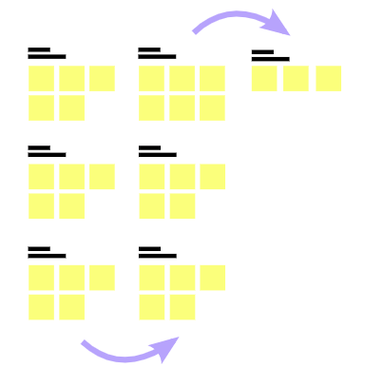
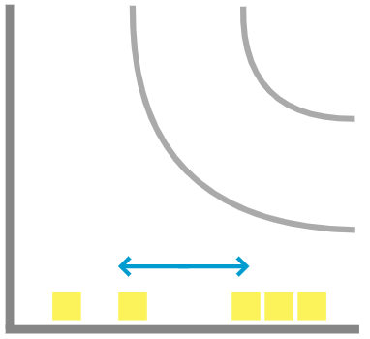
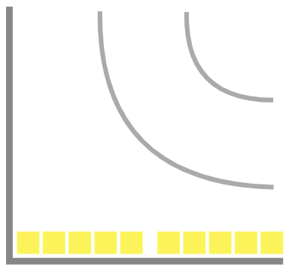
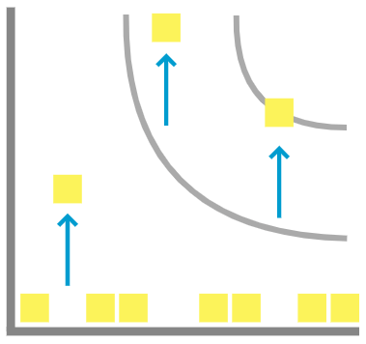
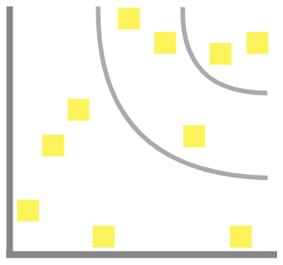

Brainstorm & Idea prioritization
Template
1
2
3
4
Before you collaborate
A little bit of preparation goes a long way with this session. Here’s what you need to do to get going.
10 minutes
Define your problem statement
What problem are you trying to solve? Frame your problem as a How Might We statement. This will be the focus of your brainstorm.
Brainstorm
Write down any ideas that come to mind that address your problem statement.
TIP
You can select a sticky note and hit the pencil [switch to sketch] icon to start drawing!
Group ideas
Take turns sharing your ideas while clustering similar or related notes as you go. Once all sticky notes have been grouped, give each cluster a sentence-like label. If a cluster is bigger than six sticky notes, try and see if you and break it up into smaller sub-groups.
TIP
Add customizable tags to sticky notes to make it easier to find, browse, organize, and categorize important ideas as themes within your mural.
Prioritize
Your team should all be on the same page about what's important moving forward. Place your ideas on this grid to determine which ideas are important and which are feasible.
TIP
Participants can use their cursors to point at where sticky notes should go on the grid. The facilitator can confirm the spot by using the laser pointer holding the H key on the keyboard.
After you collaborate
You can export the mural as an image or pdf to share with members of your company who might find it helpful.
5 minutes
10 minutes
20 minutes
20 minutes
Brainstorm
& idea prioritization
Use this template in your own brainstorming sessions so your team can unleash their imagination and start shaping concepts even if you're not sitting in the same room.
Quick add-ons
_{A} Team gathering
Define who should participate in the session and send an invite. Share relevant information or pre-work ahead.
PROBLEM
subscribers are losing interest
Person 1
Person 2
Person 3
Person 4
If the problem is caused by rushing, you have two possible solutions:
+
If the problem is caused by rushing, you have two possible solutions:
A ^{Share the mural}
Share a view link to the mural with stakeholders to keep
them in the loop about the outcomes of the session.
Set the goal
Think about the problem you'll be focusing on solving in the brainstorming session.
Was there a recent change in the type of content you publish?
Has the balance between informative content and promotional content shifted?
Did you change the layout of your newsletter?
Have you left recent newsletters to the last minute, resulting in rushed content?
Get strict about your email drafting schedule. Make a regular appointment with yourself for newsletter creation and stick to it.
Set your phone to Do Not Disturb and close your office door. Don’t let anything, even interruptions from coworkers or clients, interrupt you. If you need additional time, add it to your schedule.
B
Hire someone to do it for you. If you have employees, ask if anyone wants to manage the newsletter. If you don’t, or nobody’s interested in doing it, hire a freelance writer. There are many freelancers who
specialize in creating newsletter content, and some may offer template design services as well.
B Export the mural
Export a copy of the mural as a PNG or PDF to attach to emails, include in slides, or save in your drive.
10 minutes to prepare
1 hour to collaborate
2-8 people recommended
C
Learn how to use the facilitation tools
Use the Facilitation Superpowers to run a happy and productive session.
Get strict about your email drafting schedule. Make a regular appointment with yourself for newsletter creation and stick to it. Set your phone to Do Not Disturb and close your office door. Don’t let anything, even interruptions from coworkers or clients, interrupt you. If you need additional time, add it to your schedule.
Hire someone to do it for you. If you have employees, ask if anyone wants to manage the newsletter. If you don’t, or nobody’s interested in doing it, hire a freelance writer. There are many freelancers who specialize in creating newsletter content, and some may offer template design services as well.
Keep moving forward
Open article
Was there a recent change in the type of content you publish?
Strategy blueprint
Define the components of a new idea or strategy.
Open the template
The best fix depends on what changed. If your content or layout has changed, you might want to return to your original format or hire a designer to build new email templates. If you used to publish a 50/50 balance of informative and promotional content but you haven’t published anything educational in months, it’s time to revisit your content schedule.
Key rules of brainstorming
To run an smooth and productive session
The best fix depends on what changed. If your content or layout has changed, you might want to return to your original format or hire a designer to build new email templates. If you used to publish a 50/50 balance of informative and promotional content but you haven’t published anything educational in months, it’s time to revisit your content schedule.
The best fix depends on what changed. If your content or layout has changed, you might want to return to your original format or hire a designer to build new email templates. If you used to publish a 50/50 balance of informative and promotional content but you haven’t published anything educational in months, it’s time to revisit your content schedule.
Customer experience journey map
Understand customer needs, motivations, and obstacles for an experience.
Open the template
Stay in topic.
Encourage wild ideas.
Importance
If each of these tasks could get done without any difficulty or cost, which would have the most positive impact?
Defer judgment.
Listen to others.
Has the balance between informative content and promotional content shifted?
Strengths, weaknesses, opportunities & threats
Identify strengths, weaknesses, opportunities, and threats (SWOT) to develop a plan.
Open the template
Go for volume.
If possible, be visual.
Did you change the layout of your newsletter?
Share template feedback
Have you left recent newsletters to the last minute, resulting in rushed content?
-
-
Feasibility
Regardless of their importance, which tasks are more feasible than others? (Cost, time, effort, complexity, etc.)
+
Need some inspiration?
See a finished version of this template to kickstart your work.
Open example

Slide 6
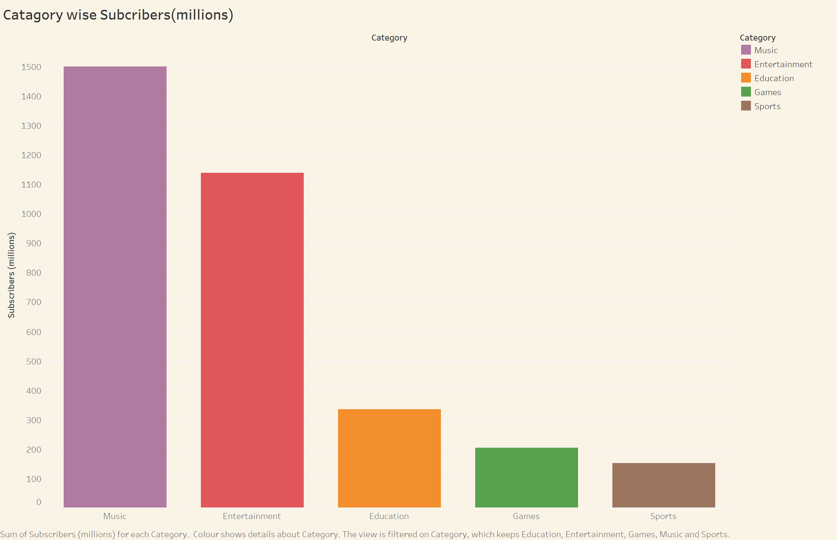

Slide 7
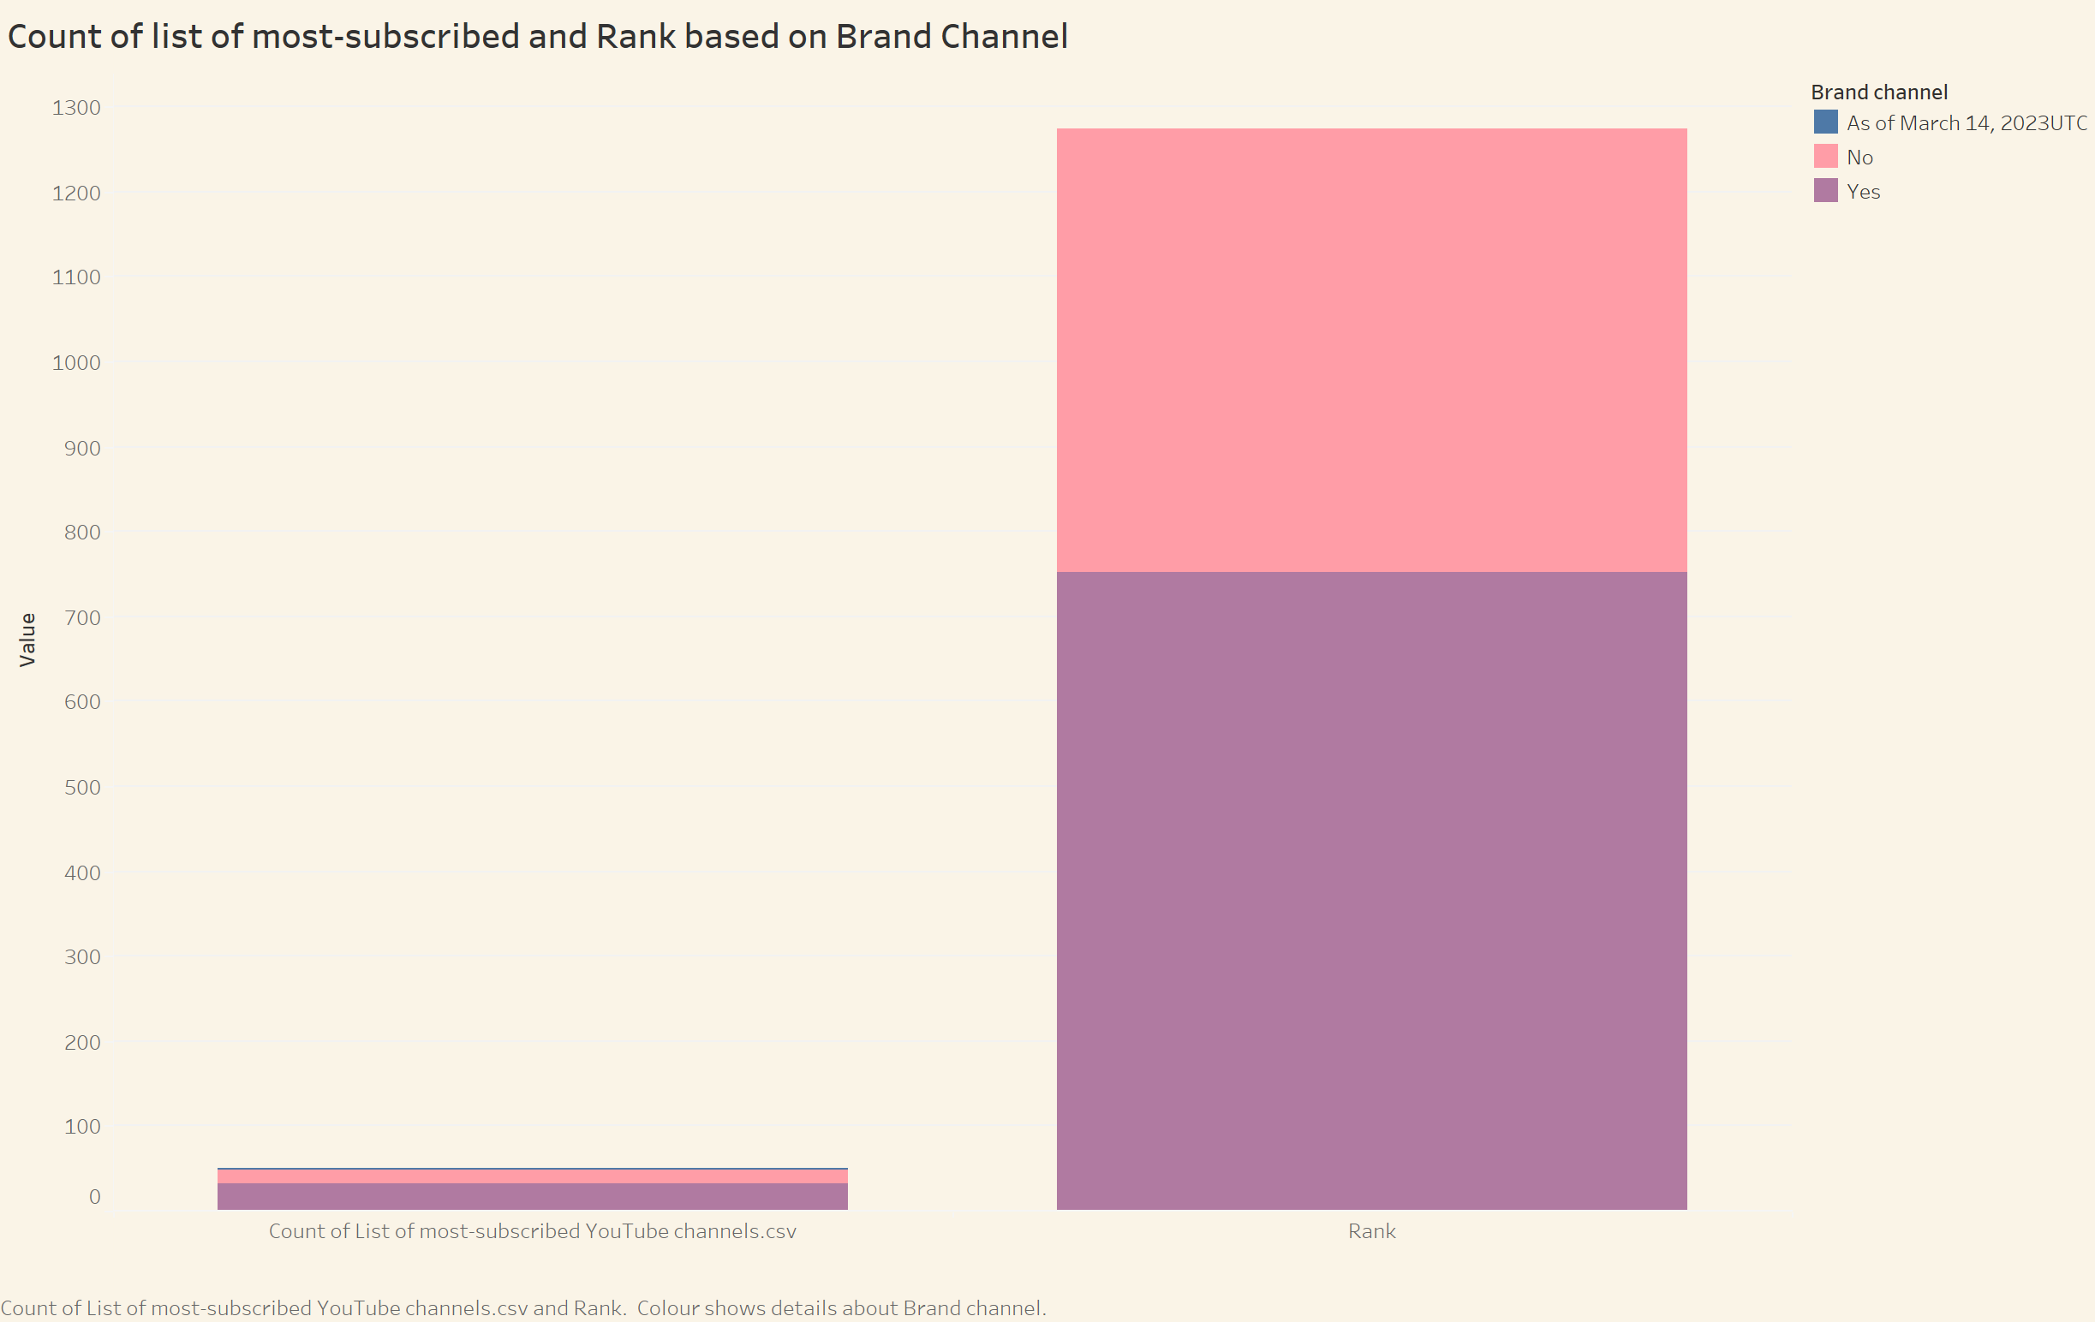

Slide 8
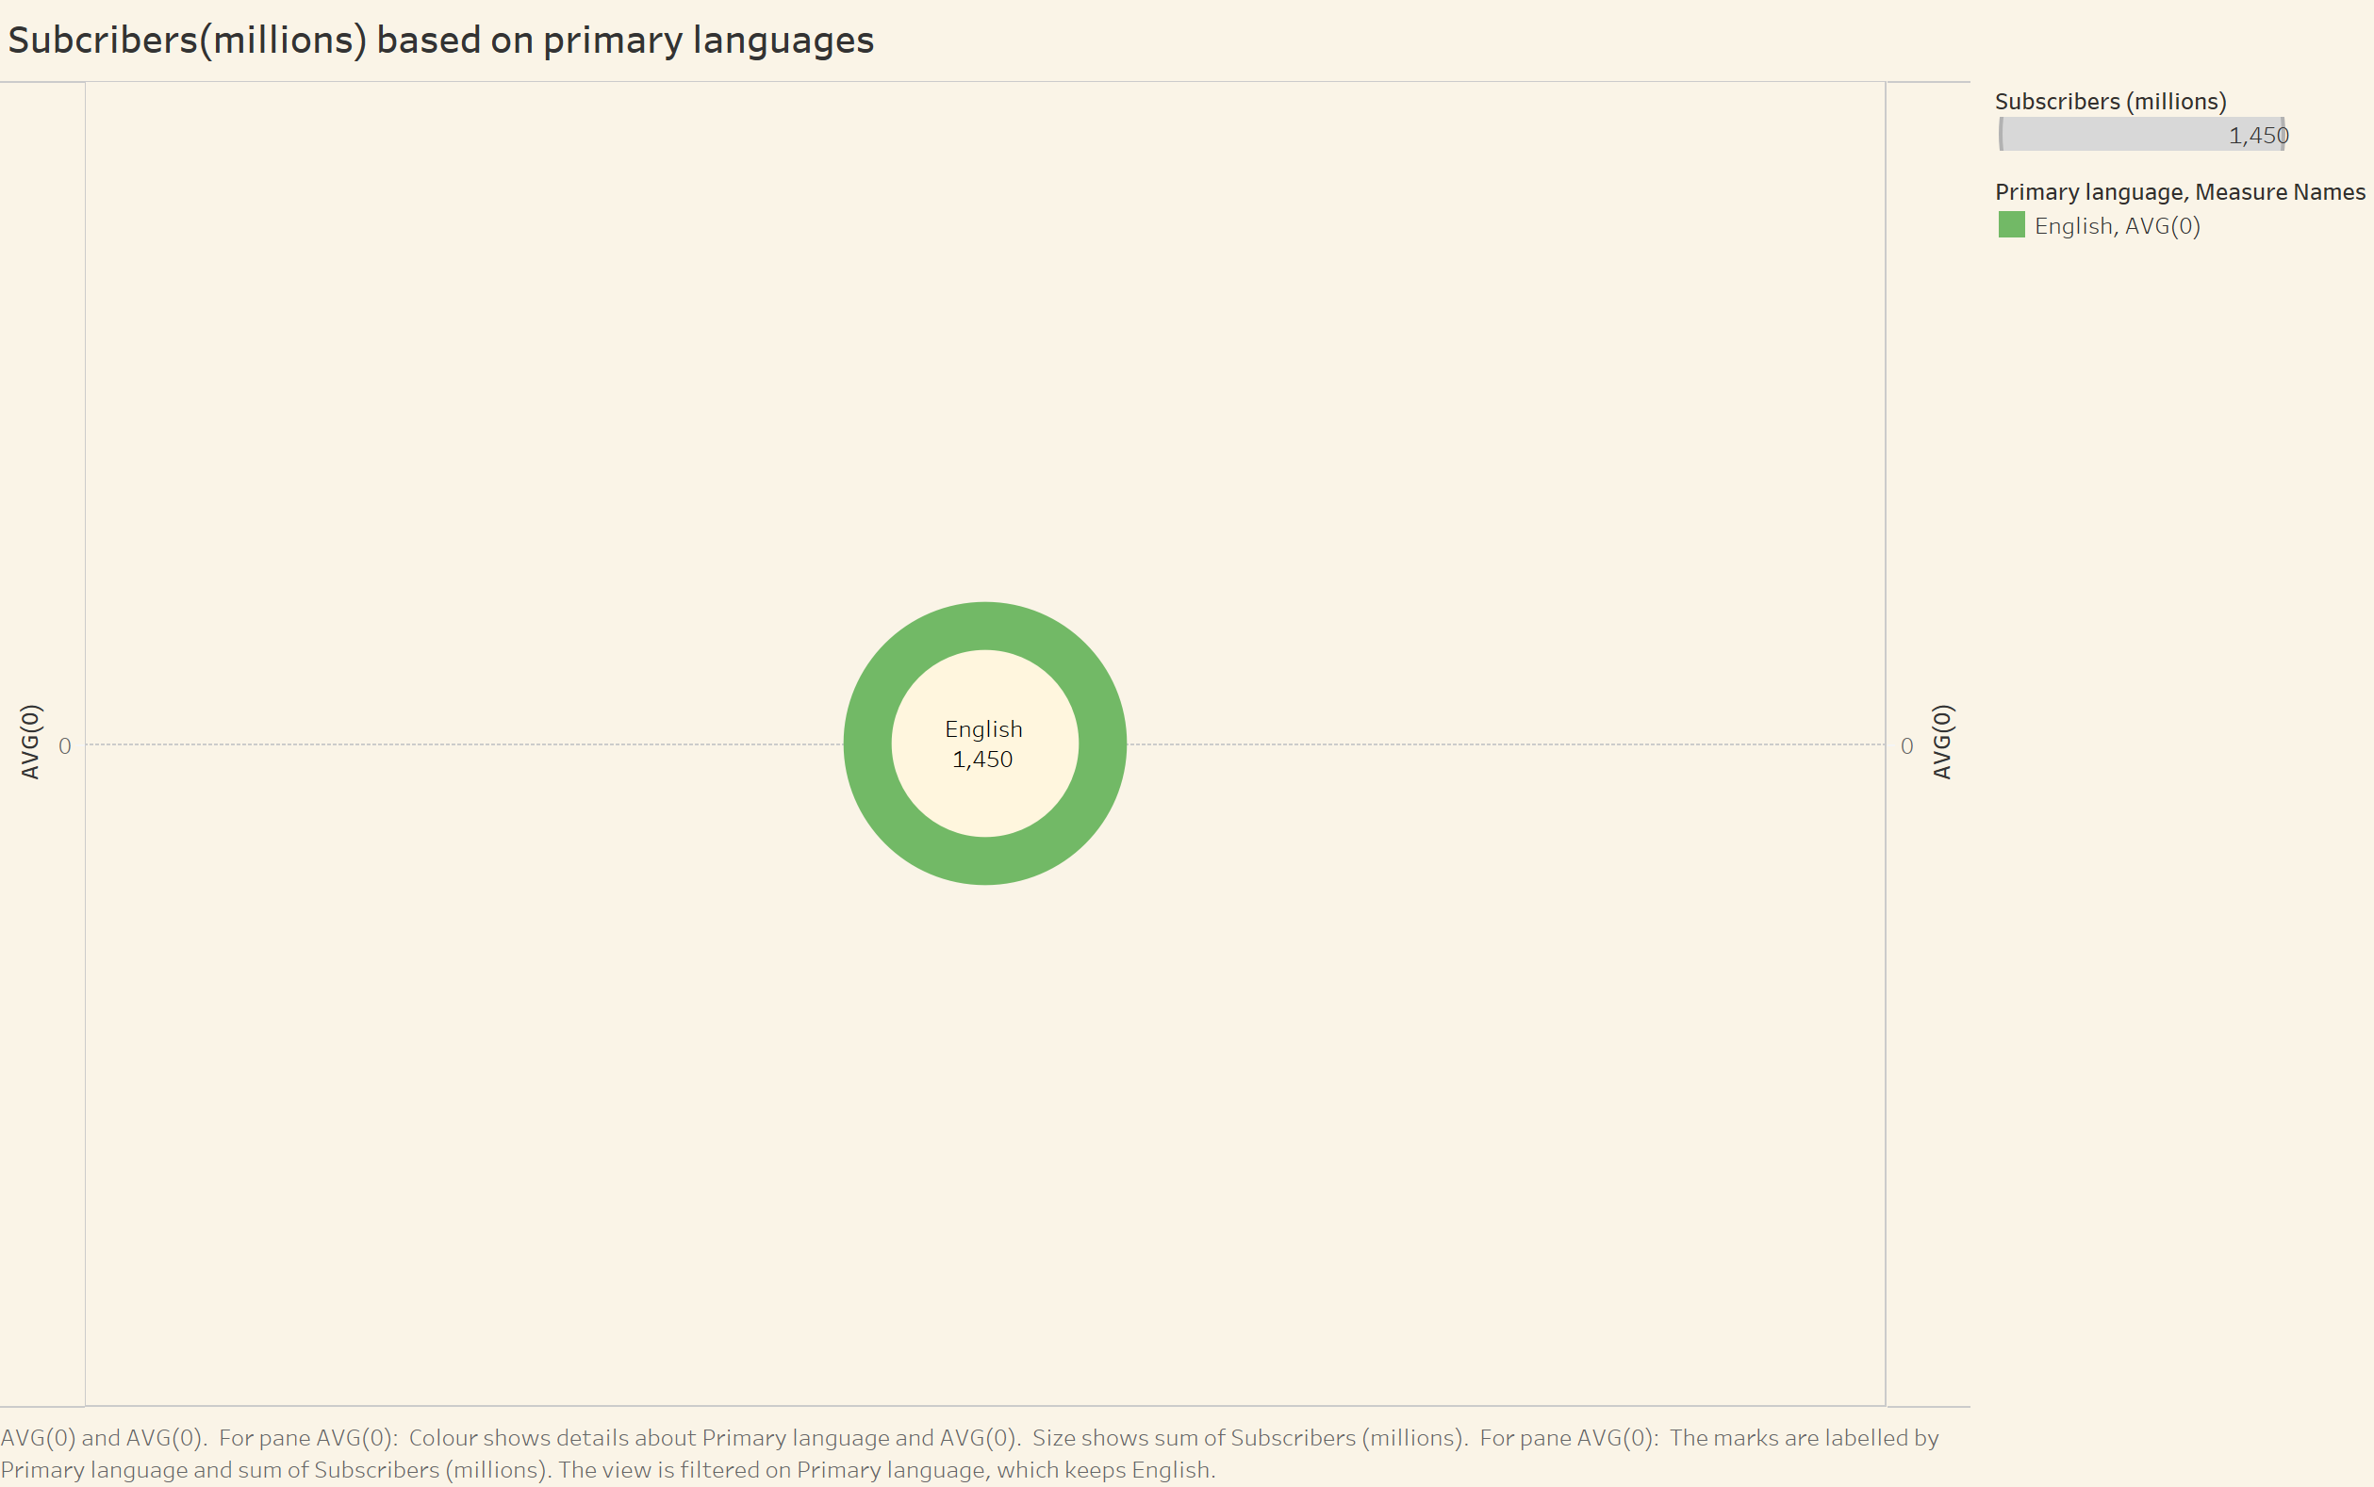

Slide 9
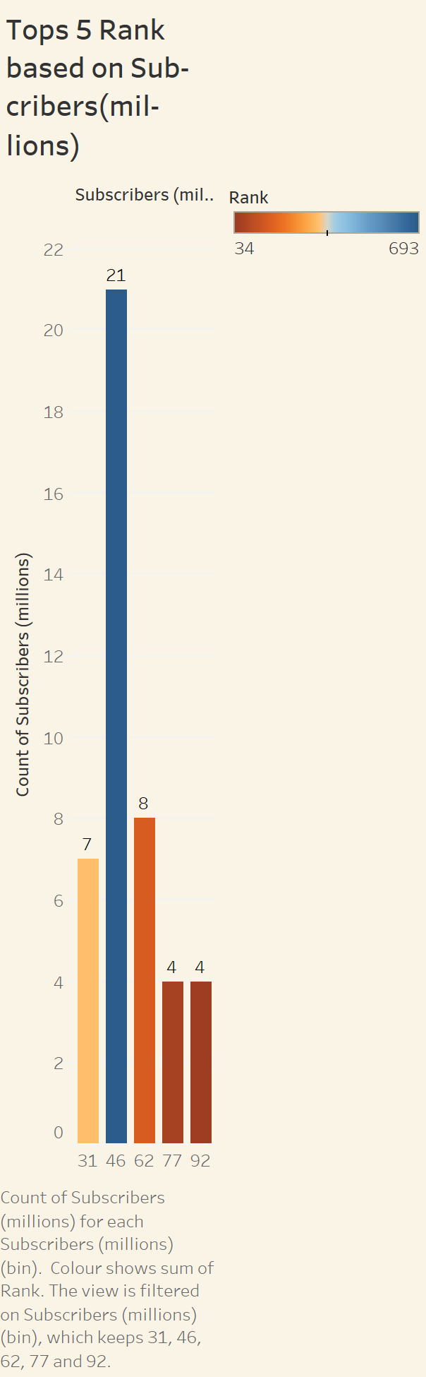
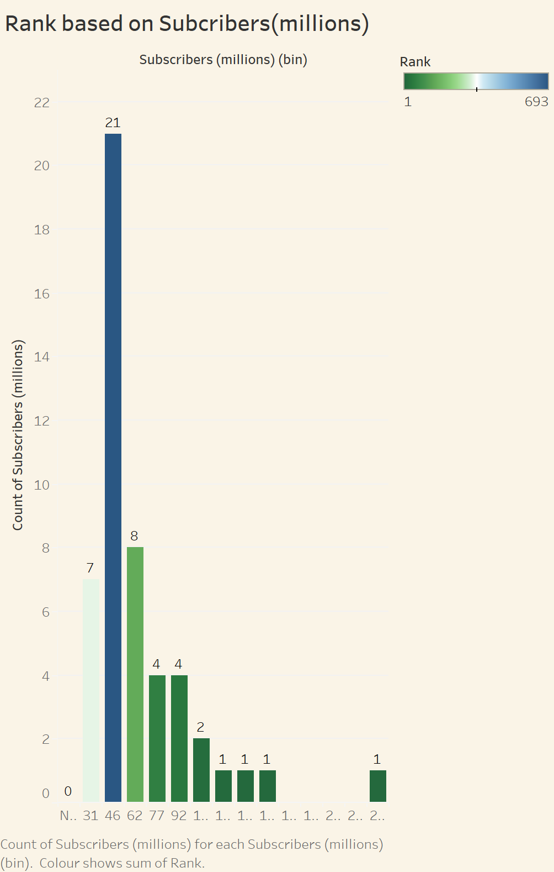

Slide 10
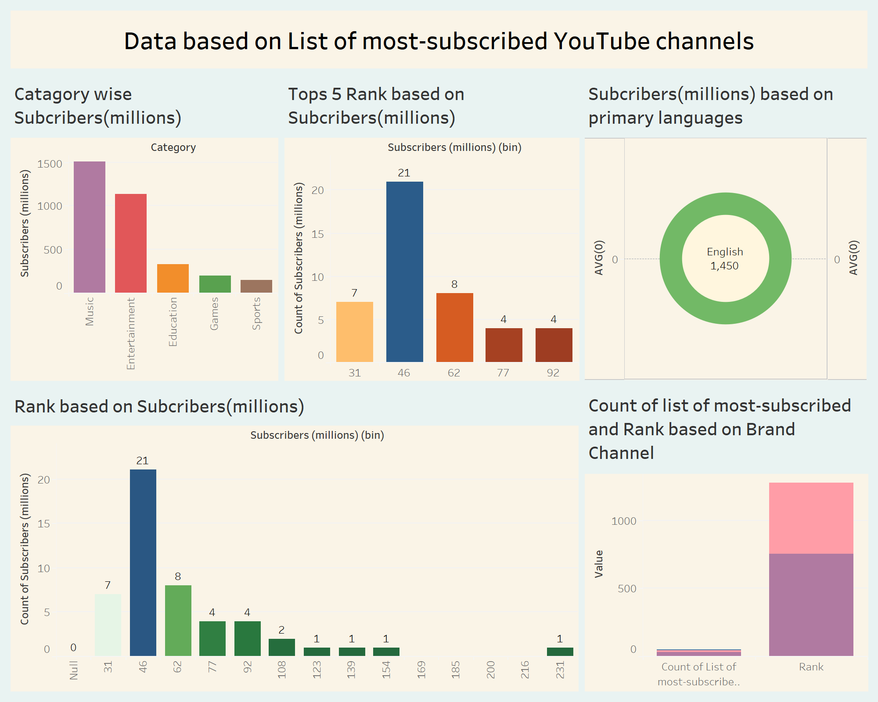

Slide 11
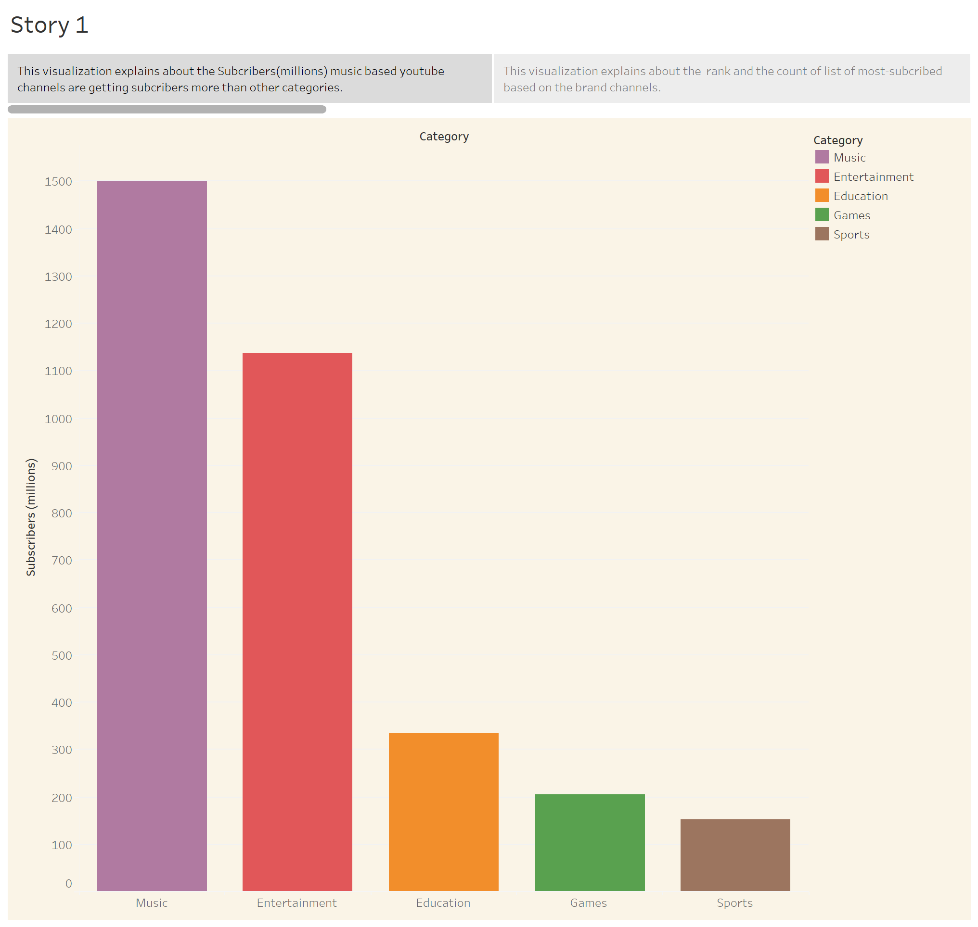
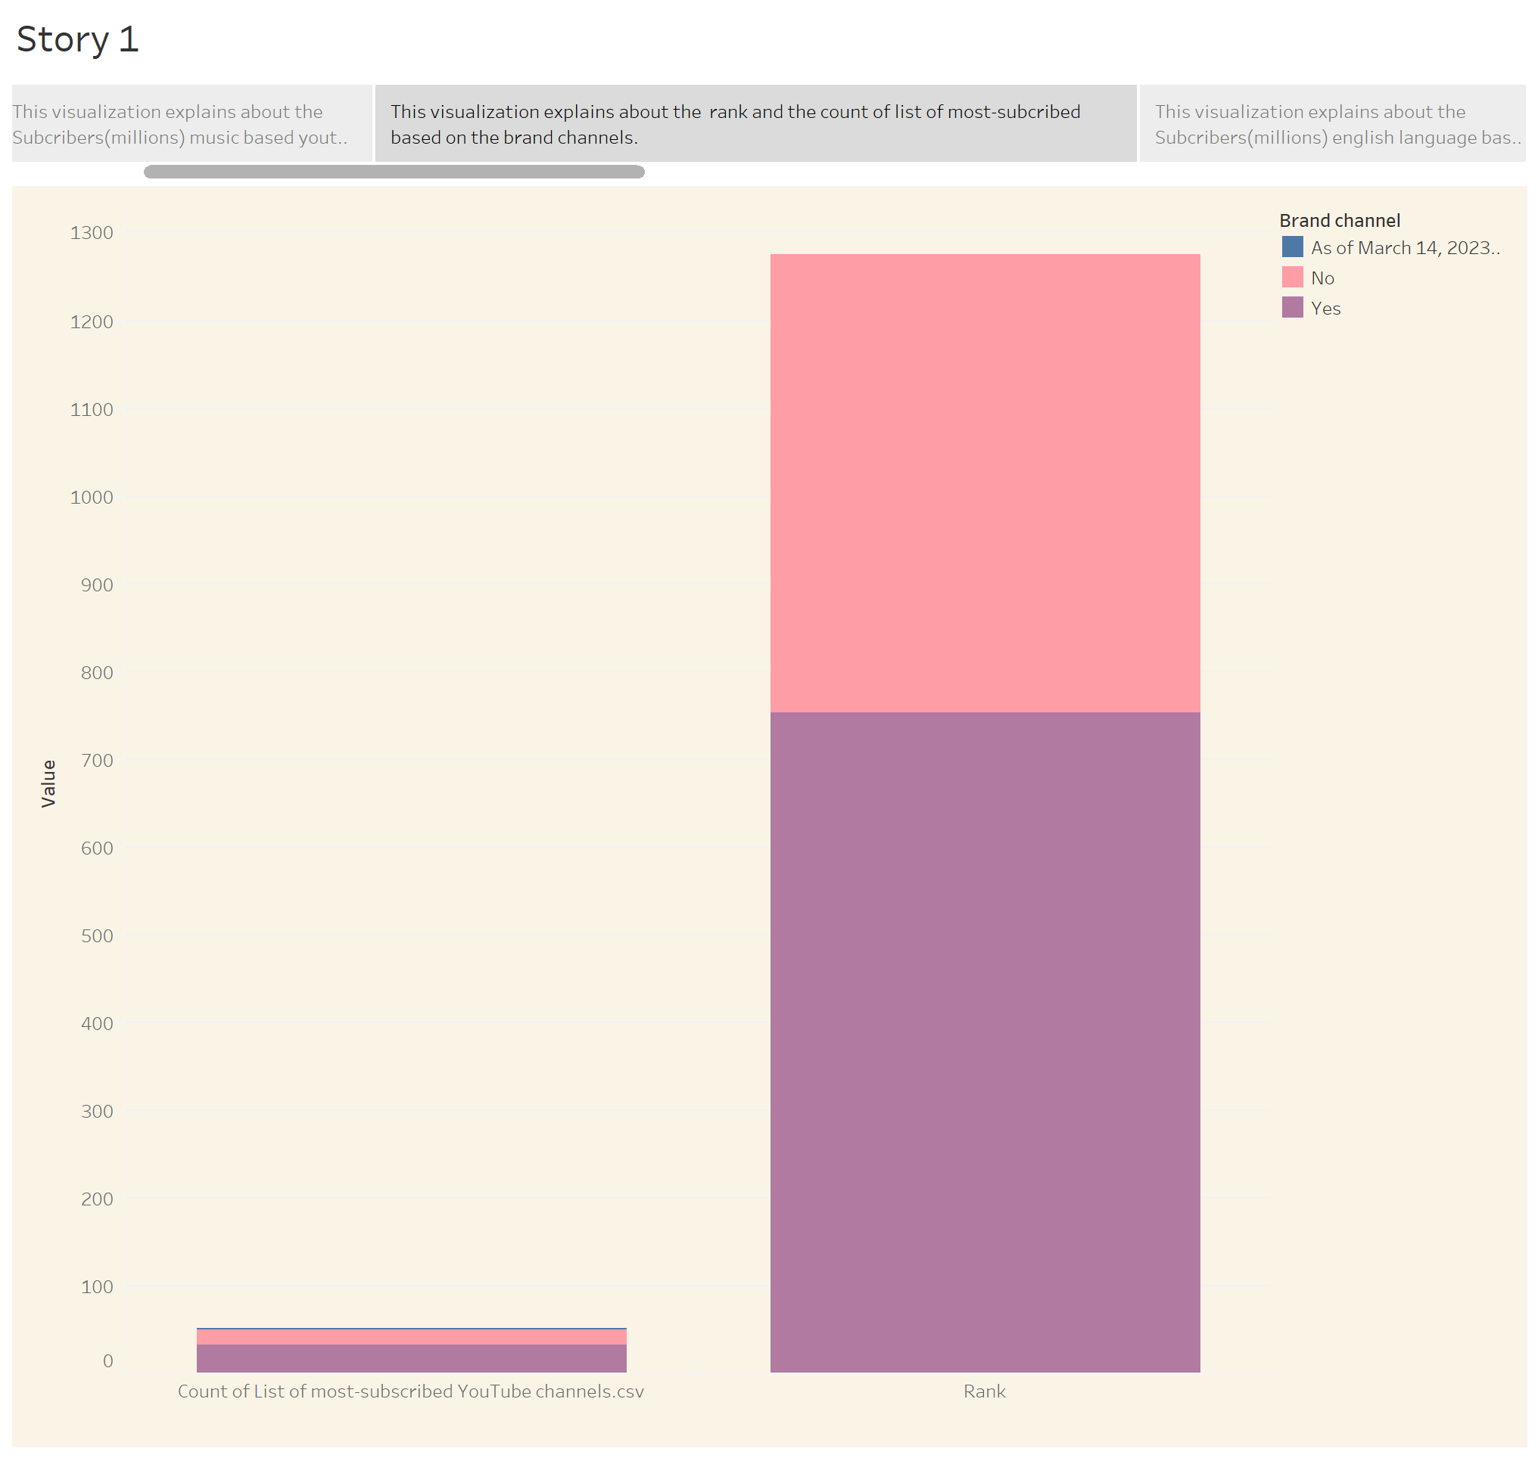
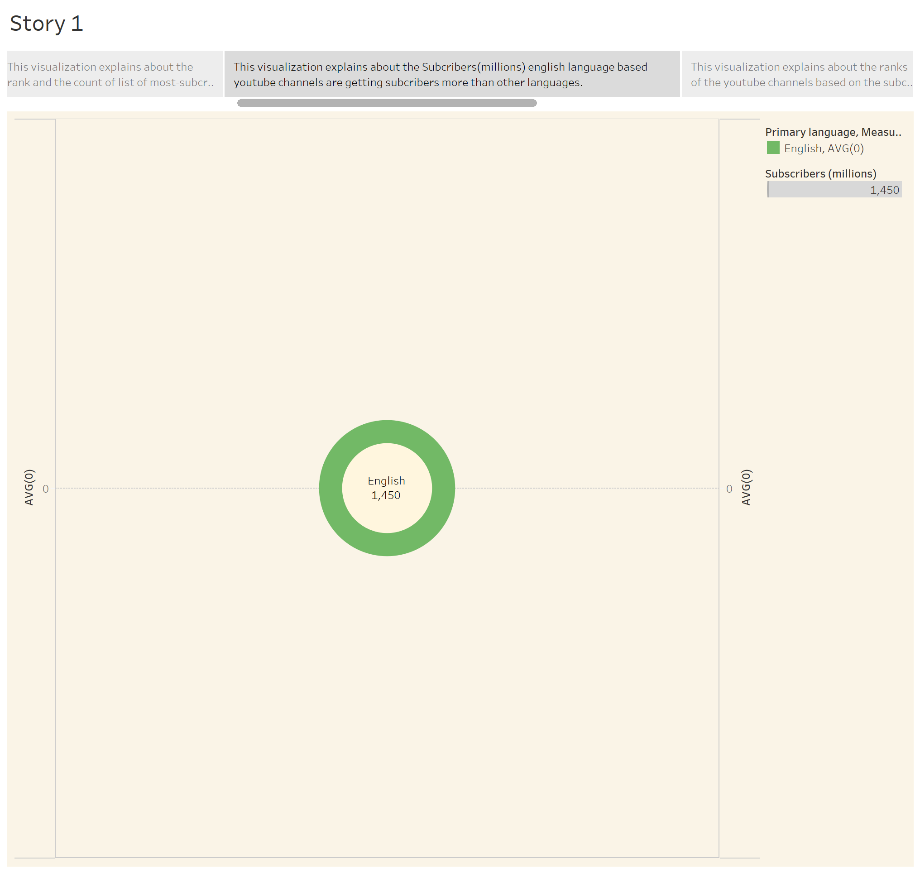
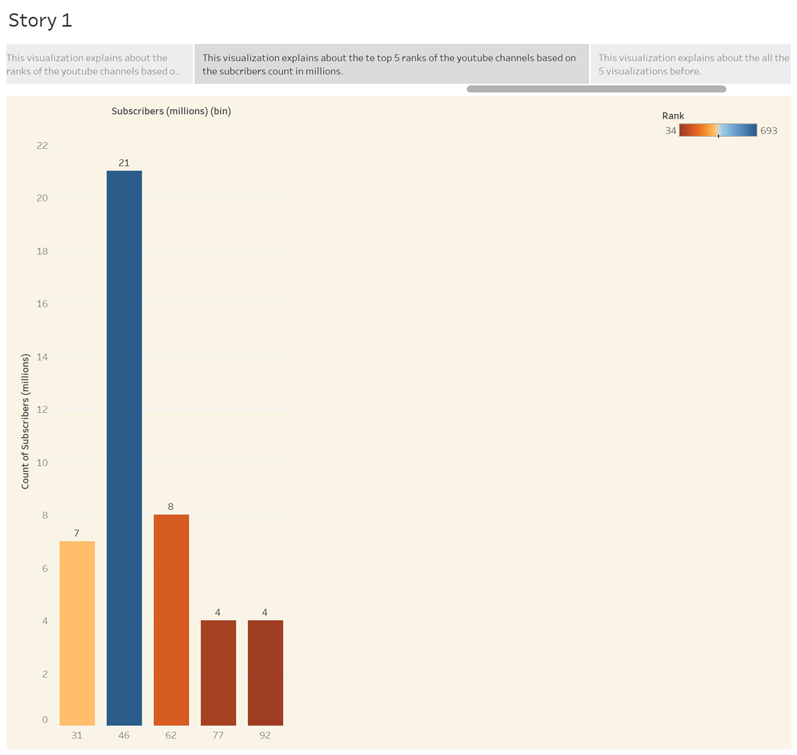
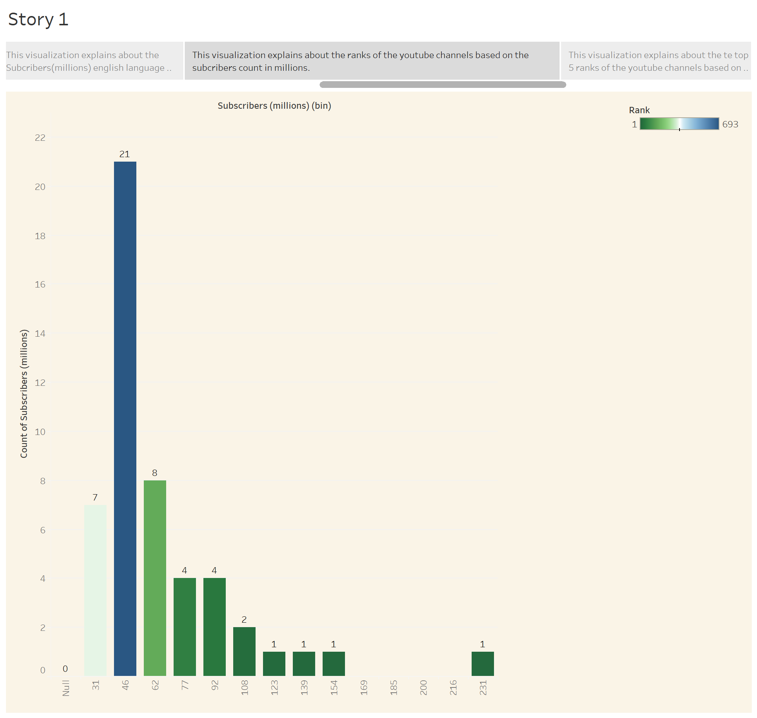
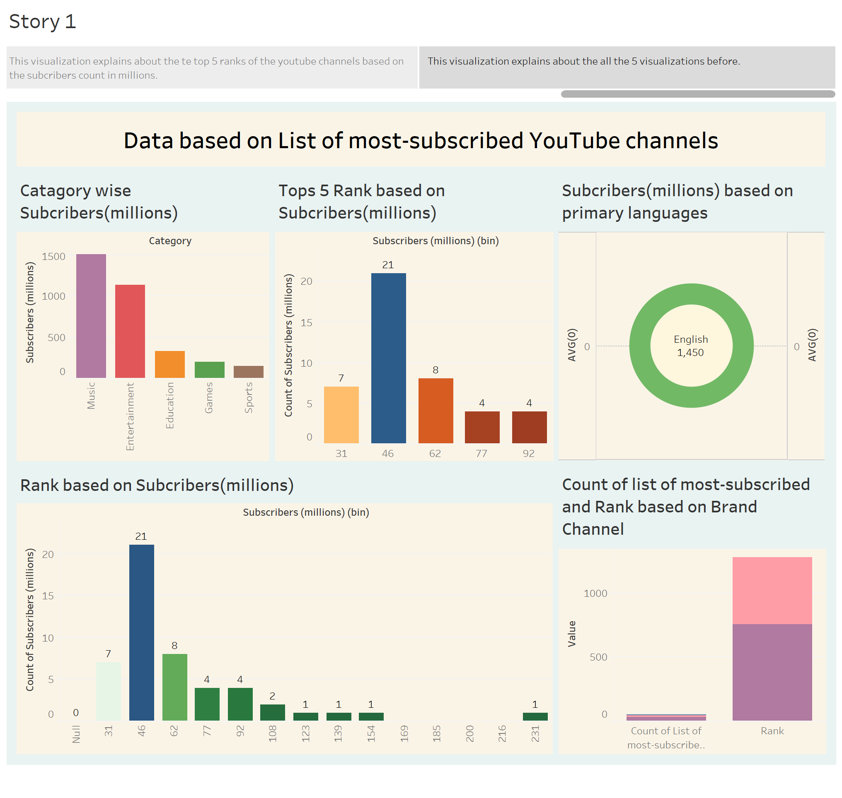

Slide 12
Advantage
YouTube as an information disseminating platform for students.
Disadvantage
Full of opportunities to develop the mental toughness it takes to overcome them.
Conclusion
These business requirements aim to create a user-friendly platform that facilitates the exploration and discovery of YouTube channels, while also providing features for personalization, social interaction, and monetization. By meeting these requirements, the platform can enhance user engagement and satisfaction, while also creating opportunities for revenue growth generation

Slide 13
The end…

